Slide 2
Year 6 Example
You will find some examples of the slides from one of the Y3 challenges.

Slide 3
Bonjour!

Slide 4
Look! I’m in France now – by the Eiffel Tower!

Slide 5
Just one more code to go – and then I’ll hopefully be back at the North Pole in time for Christmas!

Slide 6
While I was in India, you worked out the fifth word of the message for me. Can you remember what it was?

Slide 7
HAPPY!
Which means that, so far, we’ve got …
Yuletide, Season, Greetings and Happy …
So it’s time to find out what the final word is!

Slide 8
Let’s find out what sort of code we need to crack this time …

Slide 9
Positional!

Slide 10
What was the Key Number number we brought with us from the Taj Mahal?
9

Slide 11
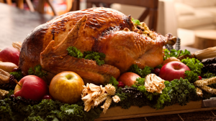
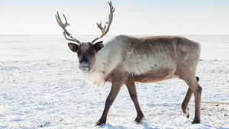
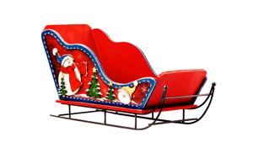
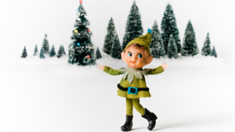
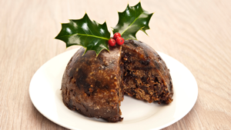
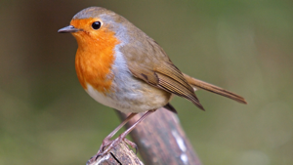
This is a five letter word.
In this code, the letters we need are hidden by pictures – like an Advent Calendar in reverse!
A | P | G | L | S
F | W | C | H | O
T | R | I | Y | E
1
2
3
4
5
6
7
8
9
10
11
12
13
14
15

Slide 12
Let’s open our first box!
The Key Number from India was nine.
So let’s open Box 9!
A | P | G | L | S
F | W | C | H | O
T | R | I | Y | E
1
2
3
4
5
6
7
8
9
10
11
12
13
14
15

Slide 13
H! Let’s put that into our word …
From Box 9, we just need to go
(7 x 4) – (9 x 3) boxes East …
A | P | G | L | S
F | W | C | H | O
T | R | I | Y | E
1
2
3
4
5
6
7
8
9
10
11
12
13
14
15
H

Slide 14
Box 10. Let’s open box 10!
O! Let’s see how that helps …
A | P | G | L | S
F | W | C | H | O
T | R | I | Y | E
1
2
3
4
5
6
7
8
9
10
11
12
13
14
15
H
O

Slide 15
Example

